Slide 1
CSI3120 Lab - Week 3
Presenter: P S Abhiram

Slide 2
Structure of this lab:
Quiz: 10 minutes
R programming: 70 minutes

Slide 3
Quiz Time optional
Please complete your quiz in the first 10 minutes of the lab

Slide 4
Binding
Run x <- 5
What happened inside the computer?

Slide 5
Binding contd..
We have put the value of 5 into a slot of memory and we have also 'bound' the name "x" to that location and value so that later we can use x and it will go to that memory location and look up the value (which is 5 until we change it to something else). This is called a static binding because the value does not change unless the program specifically makes a change.
An active(dynamic) binding is similar in that we bind a variable name (like "x") to something, but that something is not just a constant value, but rather a function that will be run every time we try to access x. So you could bind the name "x" to a function that calls rnorm and then each time you access x you would see a different random normal value.

Slide 6
Binding contd..
To summarize active or dynamic binding we can say, "A binding is static if it first occurs before run time begins and remains unchanged throughout program execution. If the binding first occurs during run time or can change in the course of program execution, it is called dynamic."

Slide 7
Bindings functions
lockEnvironment(env, bindings = FALSE)
environmentIsLocked(env)
lockBinding(sym, env)
unlockBinding(sym, env)
bindingIsLocked(sym, env)
makeActiveBinding(sym, fun, env)
bindingIsActive(sym, env)
activeBindingFunction(sym, env)

Slide 8
Arguments
Env – an environment
Bindings – logical specifying whether bindings should be locked
Sym – a name object or character string
Fun – a function taking zero or one arguments

Slide 9
Lock Environment
The function lockEnvironment locks its environment argument. Locking the environment prevents adding or removing variable bindings from the environment.
Changing the value of a variable is still possible unless the binding has been locked.
The namespace environments of packages with namespaces are locked when loaded.

Slide 10
Lock Binding
lockBinding locks individual bindings in the specified environment.
The value of a locked binding cannot be changed.
Locked bindings may be removed from an environment unless the environment is locked.

Slide 11
Make active binding
makeActiveBinding installs fun in environment env so that getting the value of sym calls fun with no arguments, and assigning to sym calls fun with one argument, the value to be assigned.
This allows the implementation of things like C variables linked to R variables and variables linked to databases, and is used to implement setRefClass.
It may also be useful for making thread-safe versions of some system globals.
Currently active bindings are not preserved during package installation, but they can be created in .onLoad.

Slide 12
Bindings Contd..
The bindingIsLocked and environmentIsLocked return a length-one logical vector.
The remaining functions return NULL, invisibly.

Slide 13
Scope of variables
Global variables: Defined for the whole source code.
Local variable: Defined only for a particular block.

Slide 14
Priorities
Block scope: Priority is given to the variable inside the block.
Global variables do not get immediate priority unless specified otherwise.

Slide 15
Assignments within functions
Note that any ordinary assignments done within the function are local and temporary and are lost after exit from the function.
Thus, an assignment X <- 5 does not affect the value of the argument in the calling program.
To understand completely the rules governing the scope of R assignments the reader needs to be familiar with the notion of an evaluation frame.
If global and permanent assignments are intended within a function, then either the “super assignment” operator, <<- or the function assign() can be used.

Slide 16
Scope
The symbols which occur in the body of a function can be divided into three classes; formal parameters, local variables and free variables.
The formal parameters of a function are those occurring in the argument list of the function. Their values are determined by the process of binding the actual function arguments to the formal parameters.
Local variables are those whose values are determined by the evaluation of expressions in the body of the functions.
Variables which are not formal parameters or local variables are called free variables. Free variables become local variables if they are assigned to

Slide 17
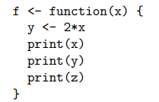
Scope contd..
Consider the following function:
In this function, x is a formal parameter, y is a local variable and z is a free variable
In R the free variable bindings are resolved by first looking in the environment in which the function was created.
This is called lexical scope.

Slide 18

Static vs Lexical Scope

Slide 19
Static vs Lexical scope
The variable n in the function sq is not an argument to that function. Therefore it is a free variable and the scoping rules must be used to ascertain the value that is to be associated with it.
Under static scope (S-Plus) the value is that associated with a global variable named n.
Under lexical scope (R) it is the parameter to the function cube since that is the active binding for the variable n at the time the function sq was defined.
The difference between evaluation in R and evaluation in S-Plus is that S-Plus looks for a global variable called n while R first looks for a variable called n in the environment created when cube was invoked.

Slide 20
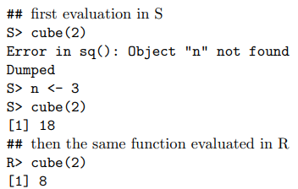

Slide 21
More on Lexical scope

Slide 22
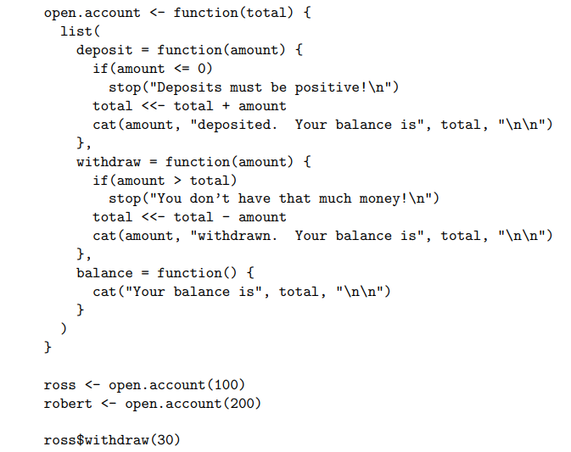
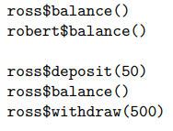

Slide 23
Explanation
In the above example we show how R can be used to mimic a bank account.
A functioning bank account needs to have a balance or total, a function for making withdrawals, a function for making deposits and a function for stating the current balance.
We achieve this by creating the three functions within account and then returning a list containing them.
When account is invoked it takes a numerical argument total and returns a list containing the three functions.
Because these functions are defined in an environment which contains total, they will have access to its value

Slide 24
Lexical scope contd..
The special assignment operator, <<-, is used to change the value associated with total.
This operator looks back in enclosing environments for an environment that contains the symbol total and when it finds such an environment it replaces the value, in that environment, with the value of right hand side.

Slide 25
Lexical Scope contd..
If the global or top-level environment is reached without finding the symbol ‘total’ then that variable is created and assigned to there.
For most users <<- creates a global variable and assigns the value of the right hand side to it .
Only when <<- has been used in a function that was returned as the value of another function will the special behavior described here occur.

Slide 26
Pointers in R
install.packages(“pointers”, dependencies = TRUE)
library(pointr)

Slide 27
Functions
ptr(symbol1, symbol2): creates a pointer called symbol1 to the object in symbol2. The function has no return value. The symbol1 pointer variable is created by the function. Both arguments, symbol1 and symbol2, are strings.
rm.ptr(symbol1, keep=TRUE) removes the pointer. It deletes the hidden access function .symbol1(). If keep == FALSE it also deletes the pointer variable symbol1. If, however keep == FALSE a copy of the object that the pointer refers to is stored in the symbol1 variable. The symbol1 argument is a string.
where(symbol1) shows the name of the object the pointer symbol1 points to. The symbol1 argument is a character vector.

Slide 28
Pointers contd..
Active bindings are used to create the pointr pointers.
For each pointer an object with active binding is created. Every time the pointer is accessed, the active binding calls a hidden function called .pointer where pointer is the name of the pointer variable.
This function evaluates the assignment (if the user assigns a value to the pointer) or evaluates the object the pointer refers to as such (if the user accesses the contents of the object the pointer points to).

Slide 29
Pointers contd..
This way it is possible not only to address objects like vectors or dataframes but also to have pointers to things like, for example, subsets of datafames.
All pointr functions operate in the environment in which the pointer is created.

Slide 30
Lab exercises
Create a similar example as shown in slide 22. Create a library where certain books are already set as global variable. The following functions must be implemented as a list
Borrow a book for 5 days. If number of days exceeds 5, then student has to pay 5 dollars. Please print a message that would state the above case.
Return a book.
If borrowed book or returned book is not in your original library, then print the message that the book does not exist in the library record.
Create your own environment. Write a function computes sum of n natural numbers using recursion in your own “Locked environment”. This means, if I call this function in another environment, it must not execute.

Slide 31
Refernces
Bindings
Scope page 46
Pointers

